Slide 1
Boosting Algorithm-Regression
Boosting algorithm is ensemble learning method
Sequentially builds multiple simple predictive models, typically decision trees, to correct the errors (residuals) of previous models,
Resulting in a single strong predictive model.
The primary goal of boosting in regression is to minimize a specified loss function (like mean squared error) by iteratively improving the model's predictions.

Slide 2
Boosting Algorithm-Regression
Key Algorithms:
Adaboost(Adaptive boosting)
XGBoost (Extreme Gradient Boosting)
LGBoost (Light Gradient-Boosting Machine)

Slide 3
Adaboost Regressor
An AdaBoost regressor is a meta-estimator.
It begins by fitting a regressor on the original dataset and then fits additional copies of the regressor on the same dataset but where the weights of instances are adjusted according to the error of the current prediction.

Slide 4
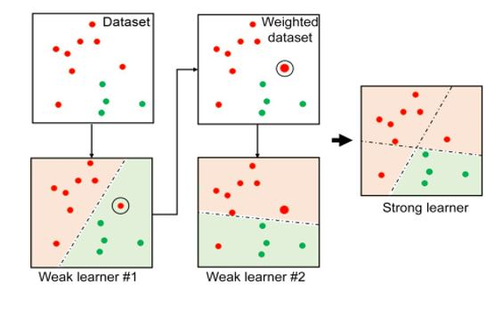
Adaboost Regressor

Slide 5
XGBoost (Extreme Gradient Boosting)
The XGBoost (eXtreme Gradient Boosting) algorithm for regression is a powerful, optimized machine learning technique that predicts continuous numerical values.
It works by sequentially building an ensemble of shallow decision trees, with each new tree trained to correct the errors (residuals) of the previous ones.

Slide 6
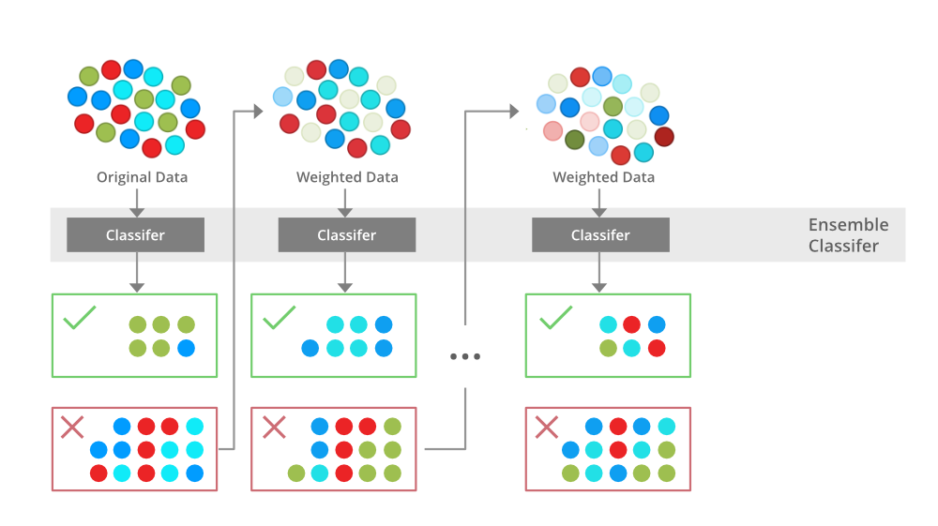
XGBoost-Regressor

Slide 7
LGBoost Regressor
LightGBM is optimized for high performance with distributed systems.
LightGBM creates decision trees that grow leaf wise, which means that given a condition, only a single leaf is split, depending on the gain.

Slide 8
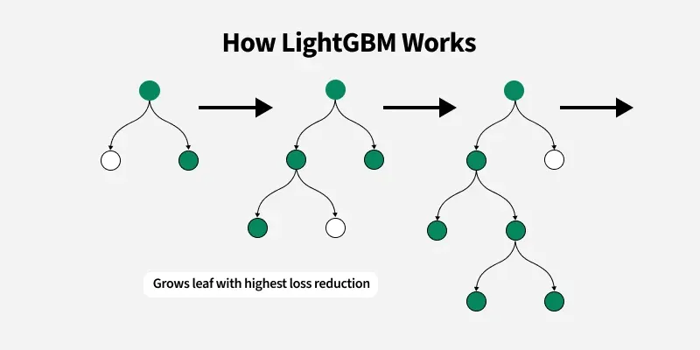
LGBoost Regressor

Slide 9
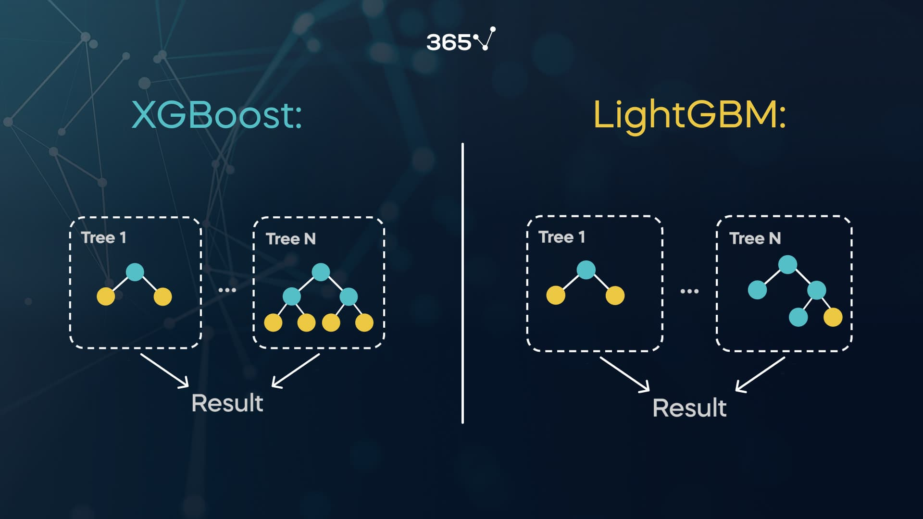
XGBoost vs LGBoost

Slide 10
Thank You……

